Slide 1

CIST 2931, Fall 2016 Weekly Report #3 10/17/2016
i c i o u s
Cnrl/alt/Delicious
Steven Alcorn, Zachary Weaver, Tyrus Skipper, Antonio Mosquera, Rupa Shrestha
Notes:
Zach

Slide 2
Tests
i c i o u s
Currently performing tests to check the saving of new notes without overwriting a current saved note in the database
Also performing tests to figure out how to fix the reject button for the Note Auditor.
Notes:
Antonio

Slide 3
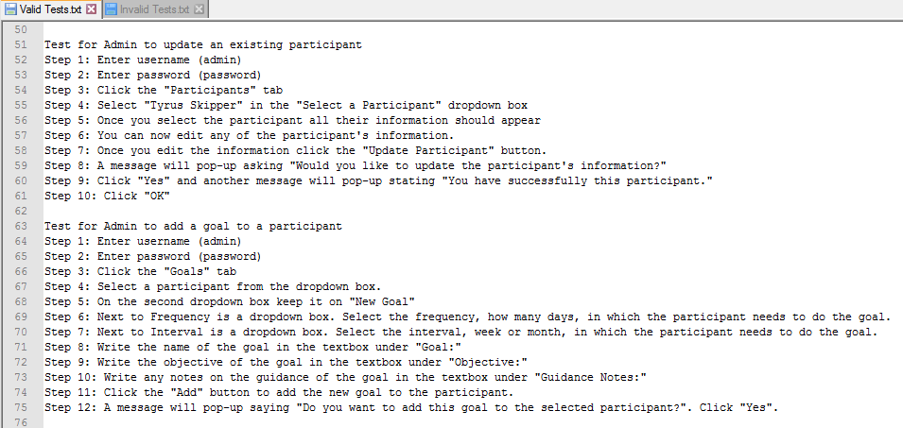
Tests
i c i o u s
Notes:
Antonio

Slide 4
Code
i c i o u s
Fixed the error when submitting a new note that was overwriting a previous saved note.
private void btn_confirmActionPerformed(java.awt.event.ActionEvent evt) {
//txt_noteContent.setText(txt_editNote.getText());
//RUPA
if (!openDocTest) {
try {
// TODO submit your handling code here:
NoteLogic note = new NoteLogic();
UserLogic user = new UserLogic();
Object tempUser = (String) activeUser;
List<NoteLogic> list1 = NoteDBConnect.selectByUser(user.select(tempUser).getUserID());
//note.submit(txt_noteContent.getText(), txt_noteComment.getText(), combo_noteChooseParticipant.getSelectedItem(), activeUser, 1);
List<NoteLogic> list2 = NoteDBConnect.selectByUser(user.select(tempUser).getUserID());
System.err.println("--------- " + tempUser + "---------");
if ((list1.size() == 1 || !list2.get(0).getTimeSubmitted().after(list1.get(0).getTimeSubmitted()))) {
if (list2.size() > 0) {
updateForm();
}
}
Notes:
Rupa

Slide 5
Code
i c i o u s
} catch (SQLException ex) {
Logger.getLogger(AdminForm.class.getName()).log(Level.SEVERE, null, ex);
} catch (ClassNotFoundException ex) {
Logger.getLogger(AdminForm.class.getName()).log(Level.SEVERE, null, ex);
}
} else {
System.out.println("your here at submit test!!!");
System.out.println("your note id: " + noteID);
System.out.println(txt_editNote.getText());
NoteDBConnect submitUpdate = new NoteDBConnect();
try {
submitUpdate.upDate(noteID, txt_editNote.getText());
submitUpdate.submitUpDate(noteID, txt_editNote.getText(), 1);
} catch (ClassNotFoundException ex) {
Logger.getLogger(AdminForm.class.getName()).log(Level.SEVERE, null, ex);
} catch (SQLException ex) {
Logger.getLogger(AdminForm.class.getName()).log(Level.SEVERE, null, ex);
}
}
}
Notes:
Rupa

Slide 6
Code
i c i o u s
private void openNote_btnActionPerformed(java.awt.event.ActionEvent evt) {
//Code implemented to open a new JFrame
dialog_editNote.show();
txt_editNote.setText(txt_noteContent.getText());
//Method to clear fields
public void reset() {
txt_noteContent.setText("");
txt_noteComment.setText("");
txt_goalDescription1.setText("");
txt_goalDescription2.setText("");
txt_goalDescription3.setText("");
txt_goalDescription4.setText("");
txt_goalDescription5.setText("");
Notes:
Rupa

Slide 7
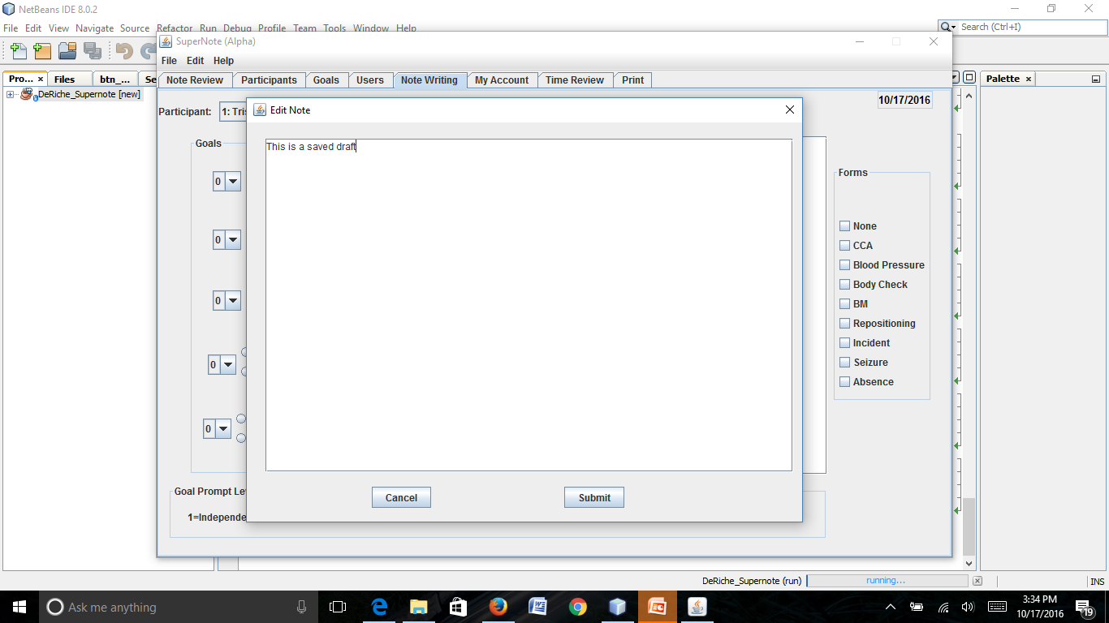
i c i o u s
Notes:
Rupa

Slide 8
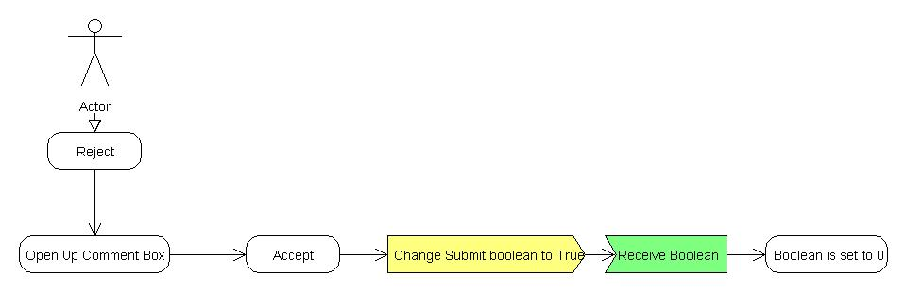
Deliverable
i c i o u s
Notes:
Steven

Slide 9
Project Plan
i c i o u s
Fix the issue of saving a note without overwriting a current note with a New Note button. (Already fixed)
Fix the Reject button for the Note Reviewer.
Notes:
Ty

Slide 10
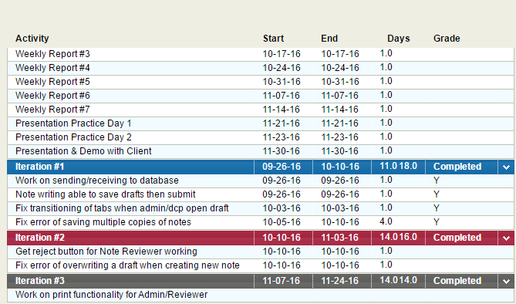
Project Plan for the Semester
Notes:
Ty

